Slide 1
Infoway Technologies Private Limited
Project Presentation on
MITTI.COM
Sr.No. | Name | PRN
1 | JAYDEEP KUMBHAR | 210543181047
2 | VAIBHAV JADHAV | 210543181031
3 | PARMESHWAR NANDGAVE | 210543181060
4 | PAWAN DUKARE | 210543181067
Under Guidance
MISS. Harshita Maheshawari

Slide 2
Project Scope
Purchasing and selling products and services over the internet without the need of going physically to the market is what online shopping all about. Online shopping is just like a retail store shopping that we do by going to the market, but it is done through the internet. Online shopping has made shopping painless and added more fun. Online stores offer product description, pictures, comparisons, price and much more.
Online shopping makes use of digital technology for managing the flow of information, products, and site owners and suppliers.

Slide 3
Modules
Admin
a. User Management
a.1 Customer (Add, Delete, List, Search)
a.2 Manager/Staff (Add, Delete, List, Search)
a.3 Seller (Add, Delete, List, Search)
b. Category Management
b.1 Add category
b.2 Delete category
b.3 List of categories
c. Product Management
c.1 Approval for product addition
c.2 List of products
c.3 Search for product details (Sort by Product Name; Seller Name; Category )
d. Total Revenue check
e. Edit Profile
f. Analysis
g.1 Rating and reviews
g.2 Feedback analysis

Slide 4
Store Manager
Stock management
a.1 Add product
a.2 Maintain product details
a.3 Inventory Report
b. Billing of Stock
c. Price and Discount
Edit Profile
List products
List Sellers with their products

Slide 5
Order Manager
Order Management
> Maintain order details
> Order Summery
b. Analysis
Customer’s cart
c. Edit Profile
d. Maintain Delivery person details for every order

Slide 6
Customer
Registration
a.1 Sign Up
a.2 Sign In
b. Search
b.1 Search Product by Name; Category
b.2 Search Categories
Add product to my cart
d. Order
1 Details
2 History
3 Issue order
4 Cancel order
5 Order Payment
e. Feedback
1. Rating and review
Edit profile
Help
FAQ
About us

Slide 7
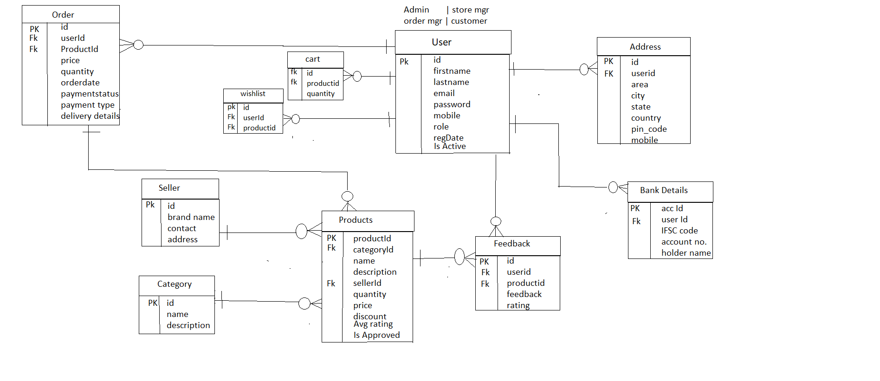
ER Diagram

Slide 8
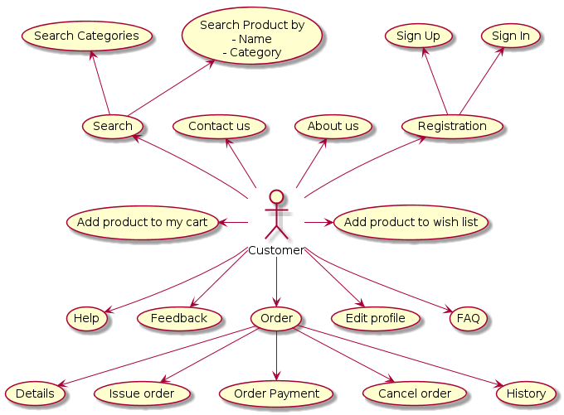

Slide 9
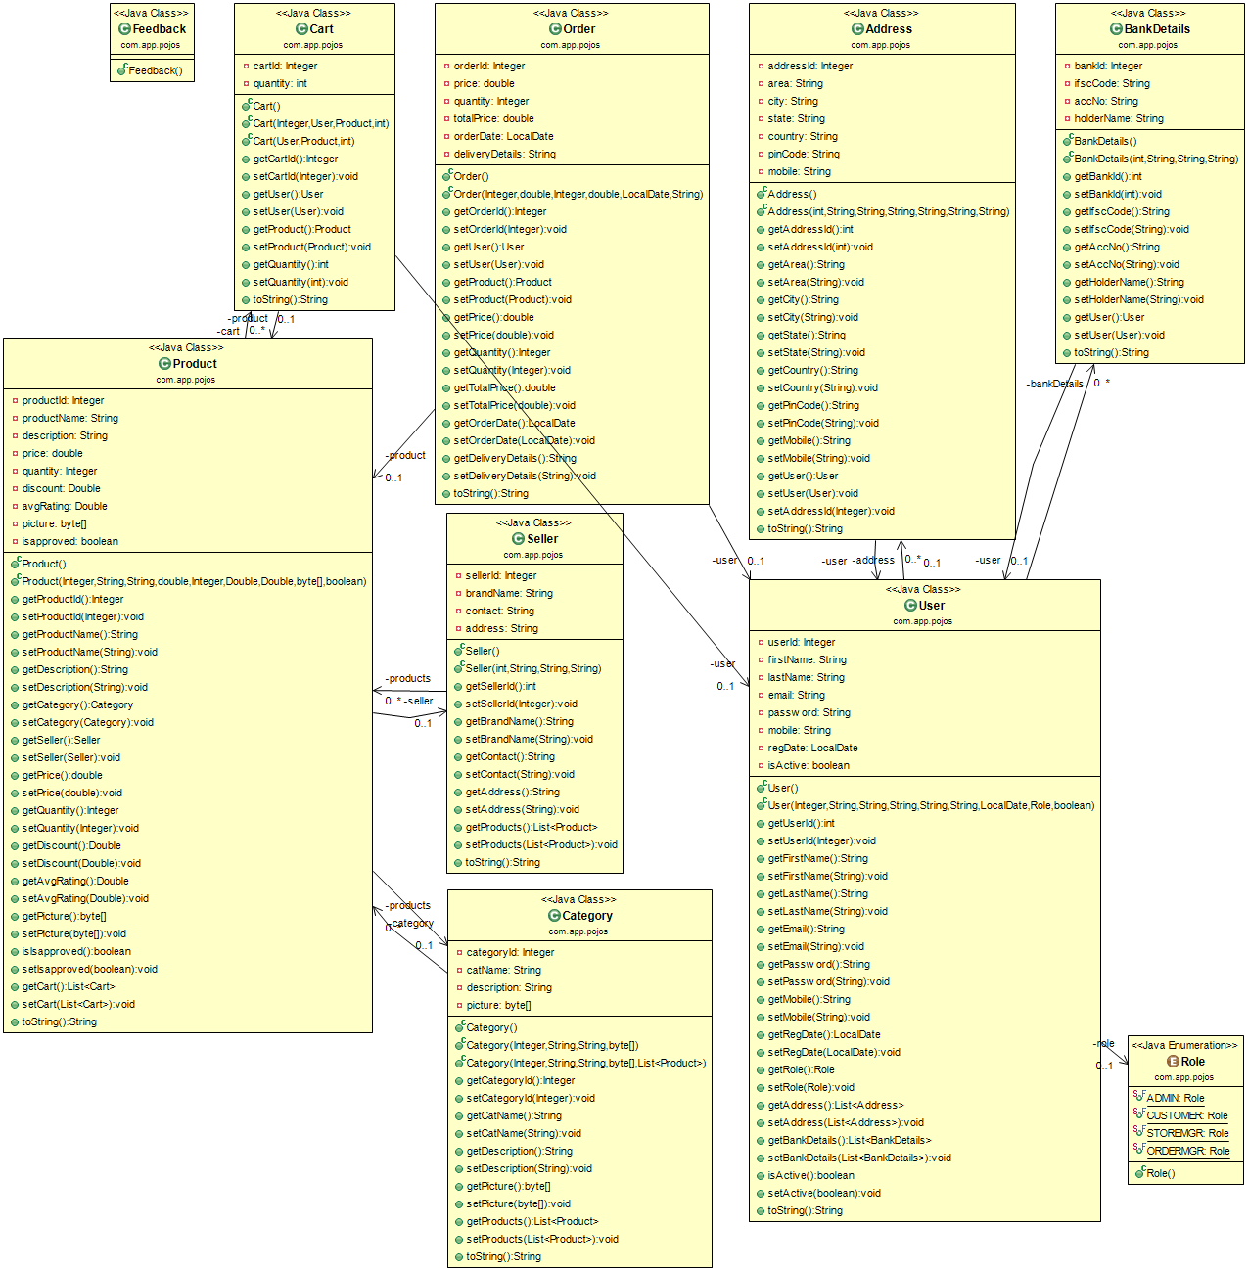

Slide 10
Thank You.!

